Slide 1
Stats Project 2 Notes

Slide 2
'data.frame': 41188 obs. of 22 variables:
$ age : int 56 57 37 40 56 45 59 41 24 25 ...
$ job : Factor w/ 12 levels "admin.","blue-collar",..: 4 8 8 1 8 8 1 2 10 8 ...
$ marital : Factor w/ 4 levels "divorced","married",..: 2 2 2 2 2 2 2 2 3 3 ...
$ education : Factor w/ 8 levels "basic.4y","basic.6y",..: 1 4 4 2 4 3 6 8 6 4 ...
$ default : Factor w/ 3 levels "no","unknown",..: 1 2 1 1 1 2 1 2 1 1 ...
$ housing : Factor w/ 3 levels "no","unknown",..: 1 1 3 1 1 1 1 1 3 3 ...
$ loan : Factor w/ 3 levels "no","unknown",..: 1 1 1 1 3 1 1 1 1 1 ...
$ contact : Factor w/ 2 levels "cellular","telephone": 2 2 2 2 2 2 2 2 2 2 ...
$ month : Factor w/ 10 levels "apr","aug","dec",..: 7 7 7 7 7 7 7 7 7 7 ...
$ day_of_week : Factor w/ 5 levels "fri","mon","thu",..: 2 2 2 2 2 2 2 2 2 2 ...
$ duration : int 261 149 226 151 307 198 139 217 380 50 ...
$ campaign : int 1 1 1 1 1 1 1 1 1 1 ...
$ pdays : int 999 999 999 999 999 999 999 999 999 999 ...
$ previous : int 0 0 0 0 0 0 0 0 0 0 ...
$ poutcome : Factor w/ 3 levels "failure","nonexistent",..: 2 2 2 2 2 2 2 2 2 2 ...
$ emp.var.rate : num 1.1 1.1 1.1 1.1 1.1 1.1 1.1 1.1 1.1 1.1 ...
$ cons.price.idx: num 94 94 94 94 94 ...
$ cons.conf.idx : num -36.4 -36.4 -36.4 -36.4 -36.4 -36.4 -36.4 -36.4 -36.4 -36.4 ...
$ euribor3m : num 4.86 4.86 4.86 4.86 4.86 ...
$ nr.employed : num 5191 5191 5191 5191 5191 ...
$ Subscription : Factor w/ 2 levels "no","yes": 1 1 1 1 1 1 1 1 1 1 ...

Slide 3
Emp var rate
Cons price
Cons conf
Euribor
Nr employed
Job
Education
Default
Contact
Month
Poutcome

Slide 4
There are only 3 yes defaults
PCs
1,6
1,7
1,8
Job*age -
Job*emp.var.rate -
Job*nr.employed +
Job*Euribor +
Marital*Euribor -
Workforce*nr.employed +
Previouscontact*nr.employed -
Contact*nr.employed +

Slide 5
simple
pdays + nr.employed + emp.var.rate + euribor3m + duration

Slide 6
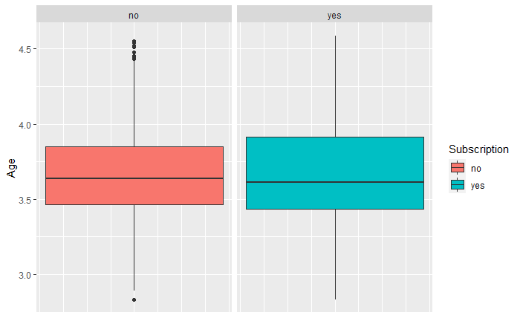
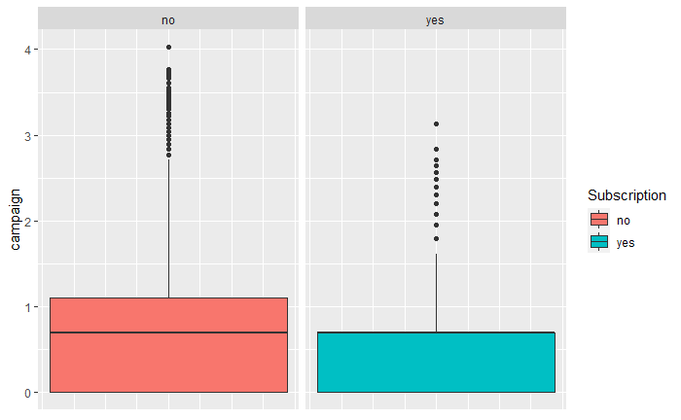
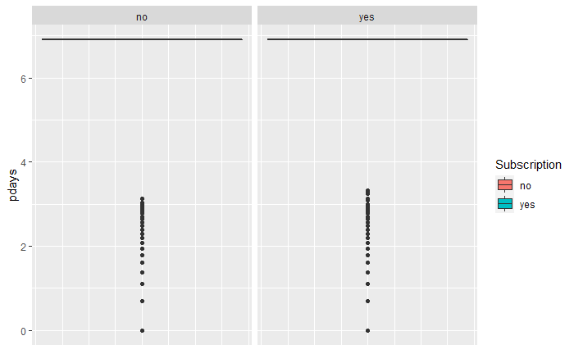
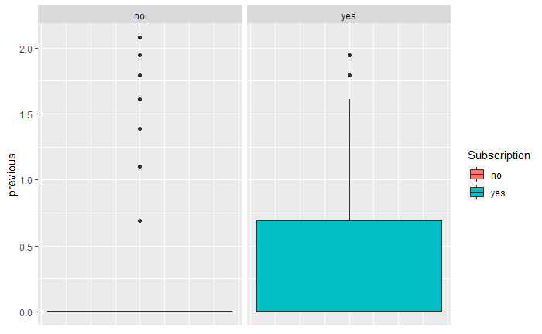
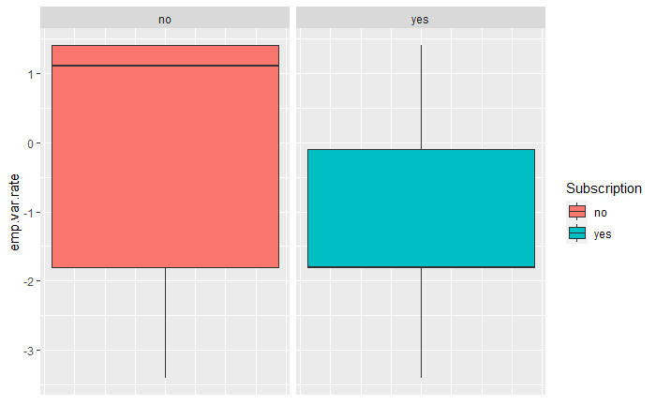
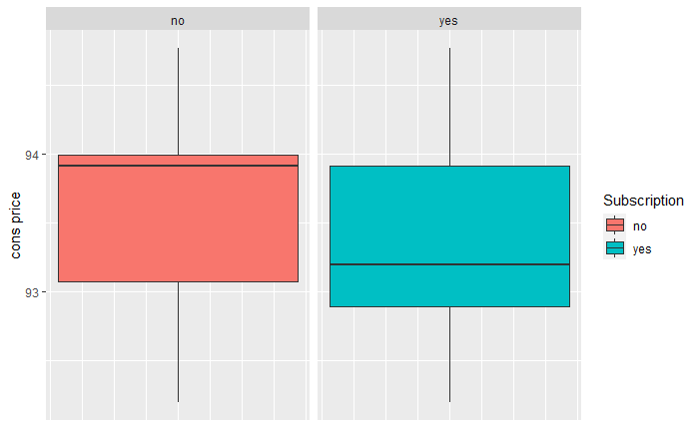
Continuous Predictors vs Response 1
Create a custom categorical
Create a custom categorical

Slide 7
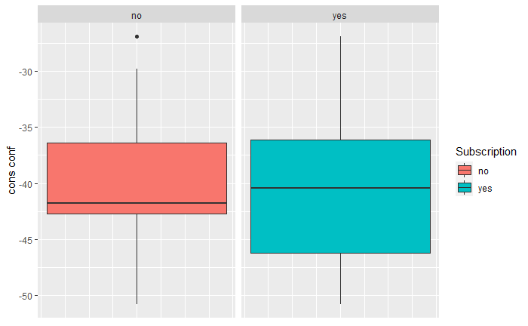
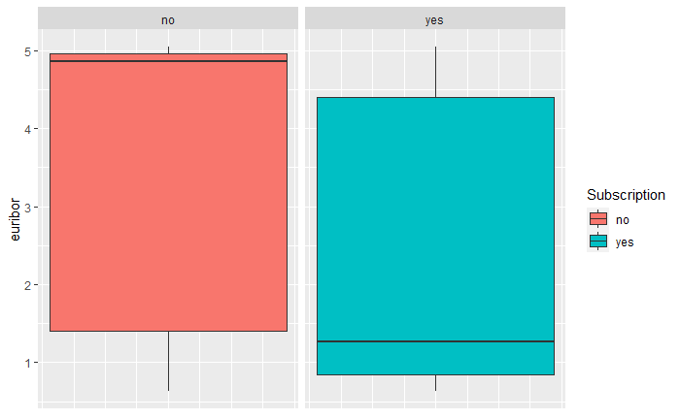
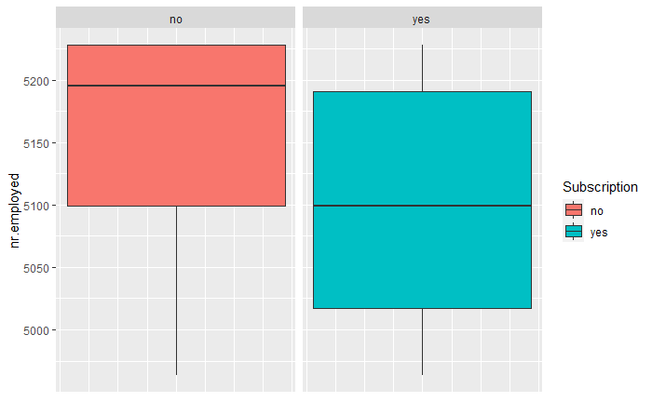
Continuous Predictors vs Response 2

Slide 8
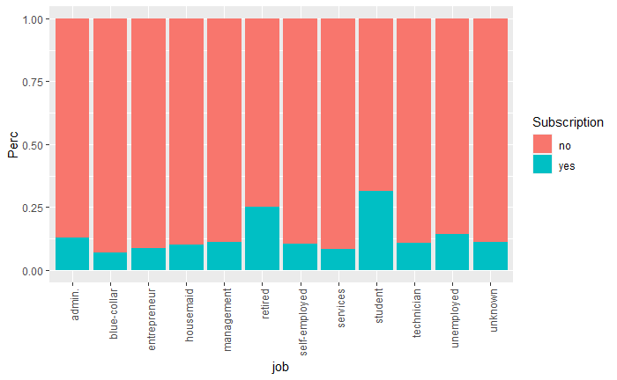
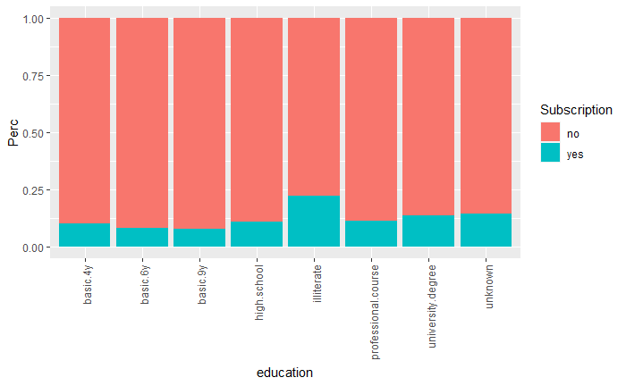
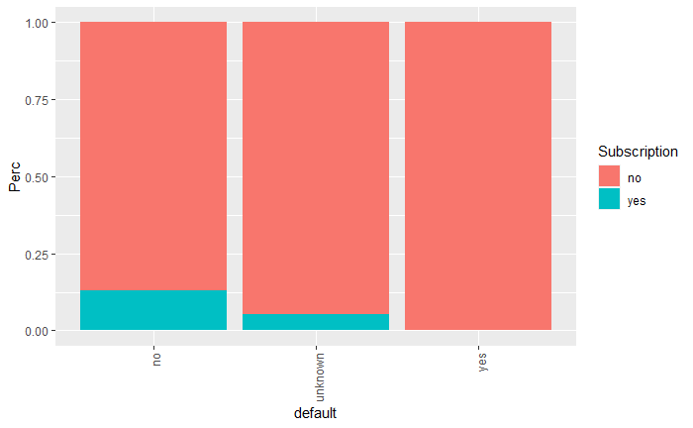
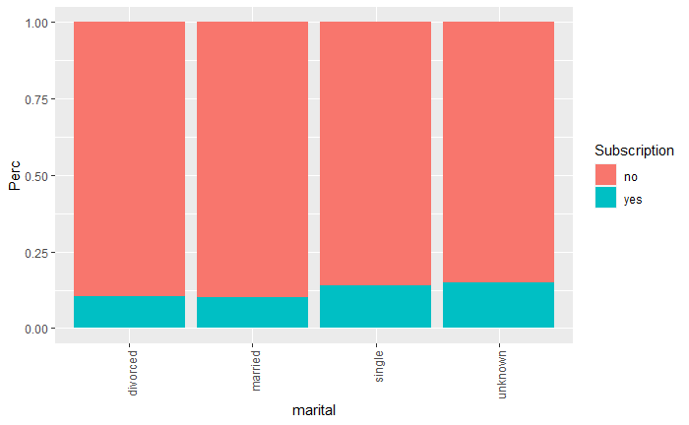
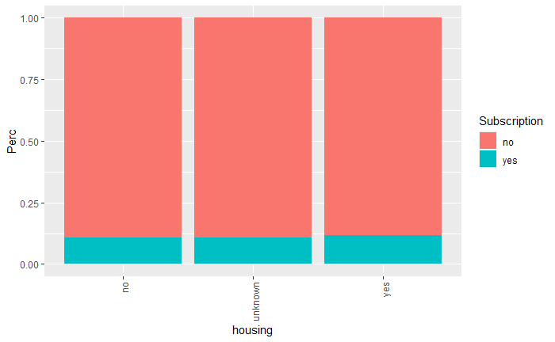
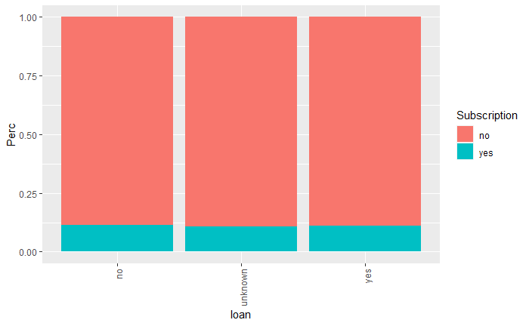
Categorical Relationship to Response 2
Split job into workforce and not (Retired, Student, unemployed)

Slide 9
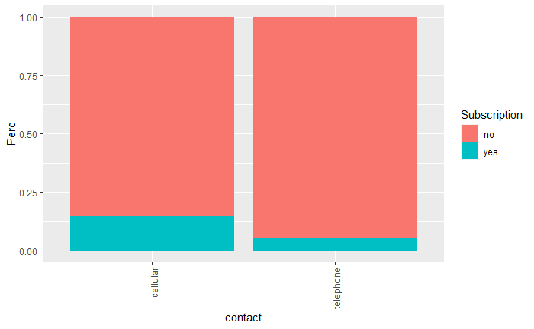
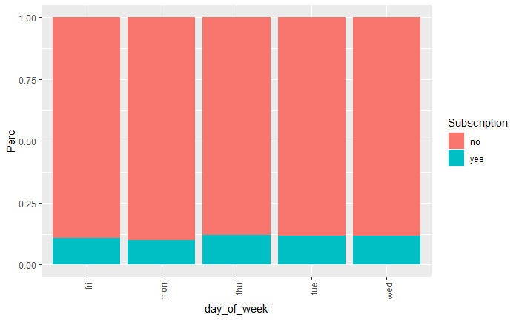
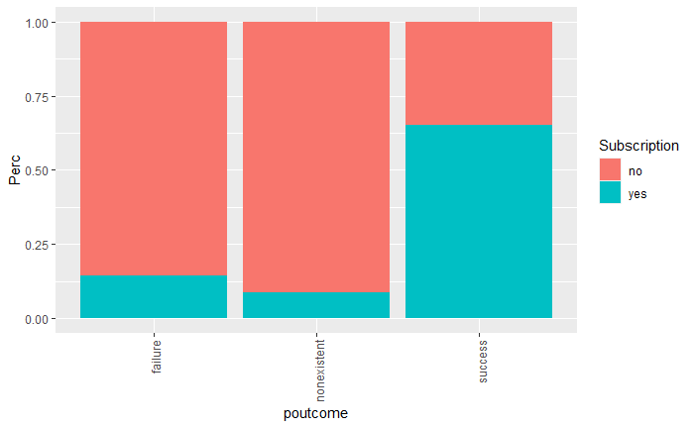
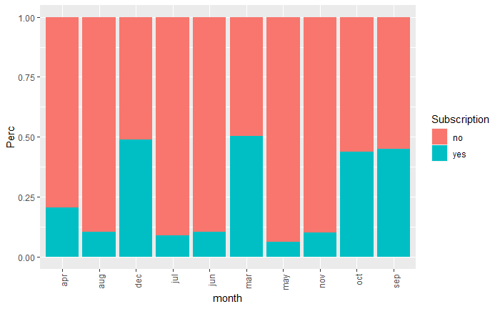
Categorical Relationship to Response
Contacted before and Uncontacted

Slide 10
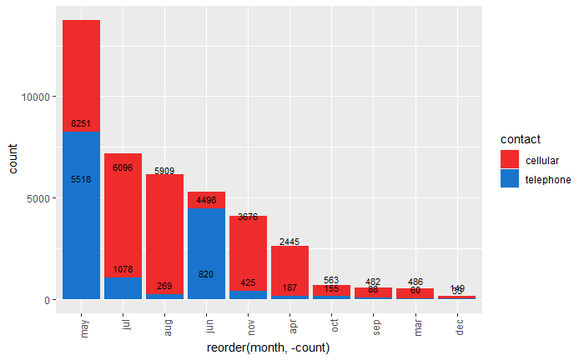
Call Type by month compared to Success Rate by Month
March, December, October, and September have the highest rates of success on calls but they are also the 4 least called months

Slide 11
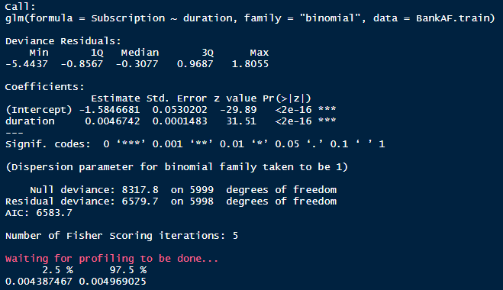
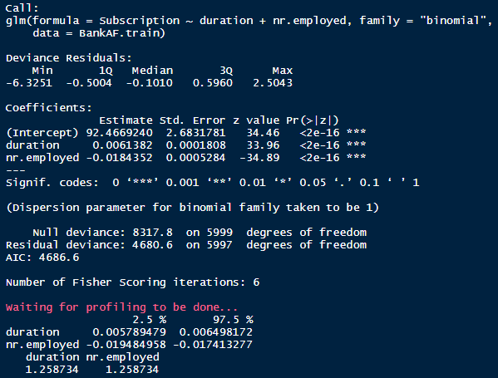
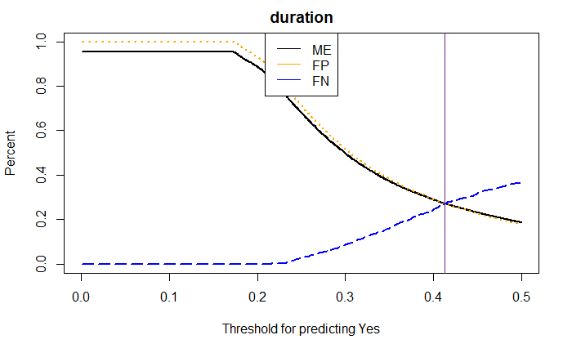
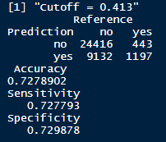
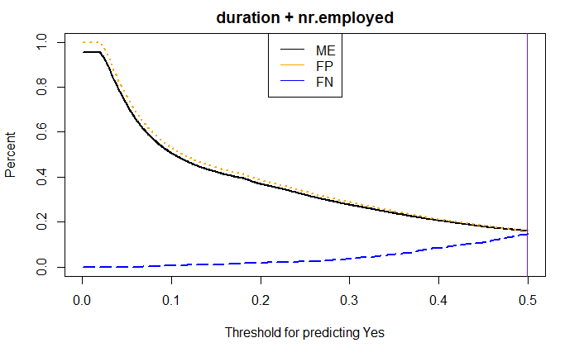
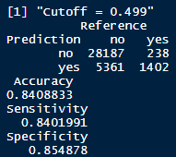
Simple Log Progression I

Slide 12
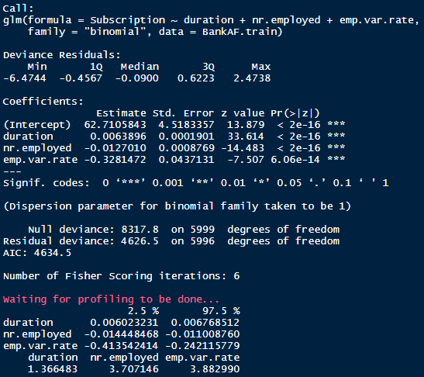
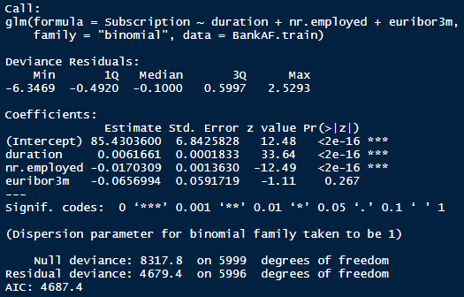
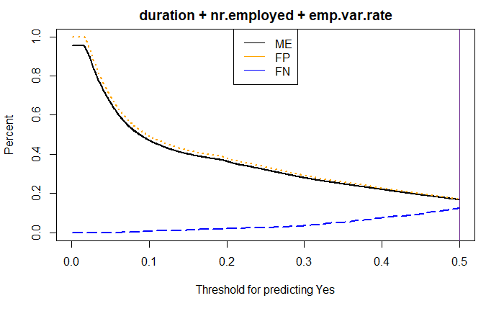
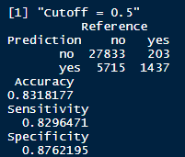
Simple Log Progression I
Euribor3m not significant here wow! From future models and selections looks like we only need one of either Euribor3m or nr. employed

Slide 13
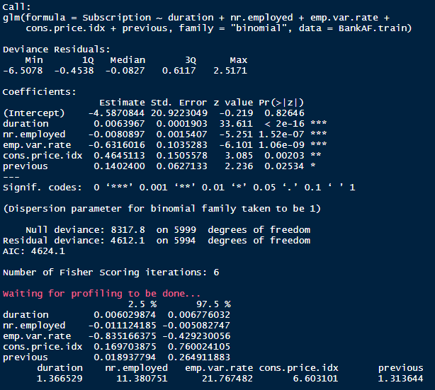
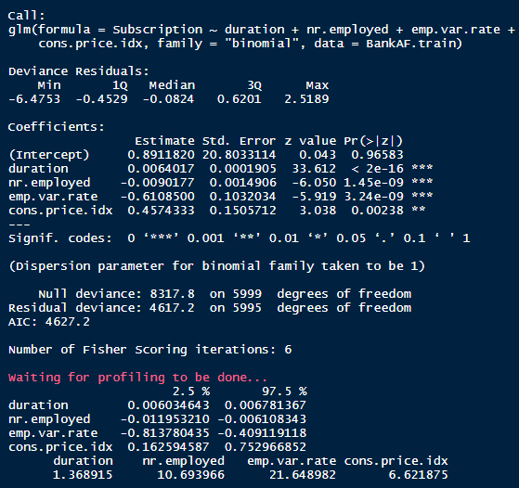
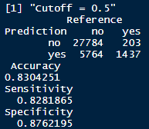
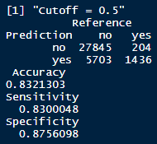
Simple Log Progression I
Start of VIF issues maybe scale emp.var.rate – corr is 0.91 between them
Splitting hairs now

Slide 14
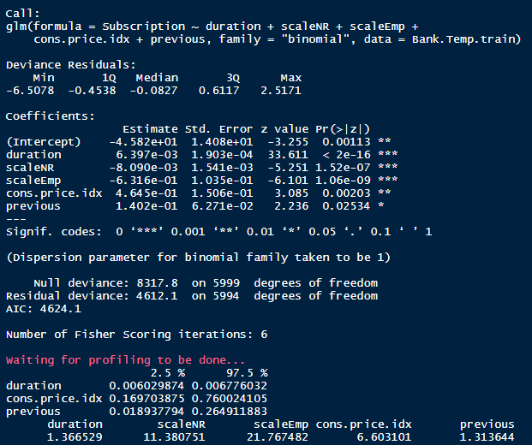
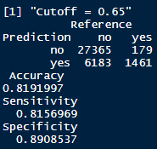
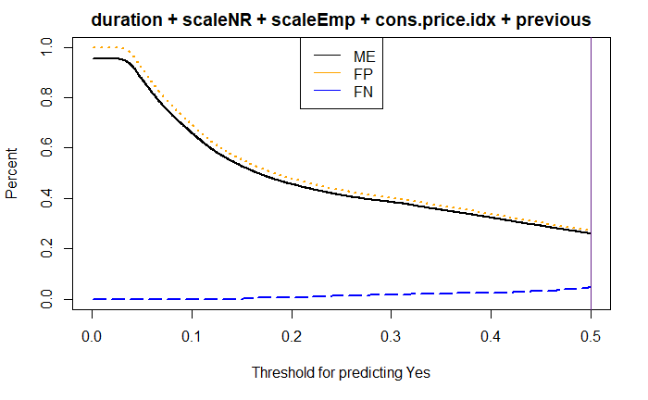
Simple Log Progression I
Attempted to scale, results mixed. Can get to comparable accuracies, moves the cut-off to like 0.65, no more confidence intervals for those, and VIF is still there….

Slide 15
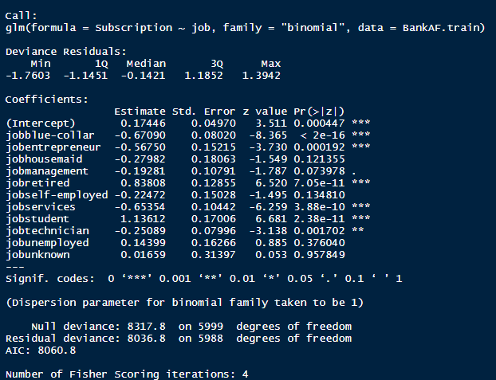
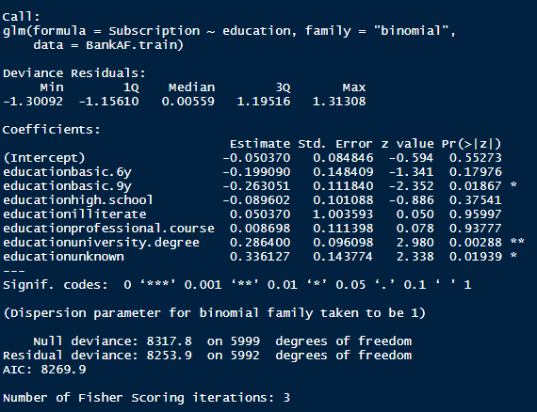
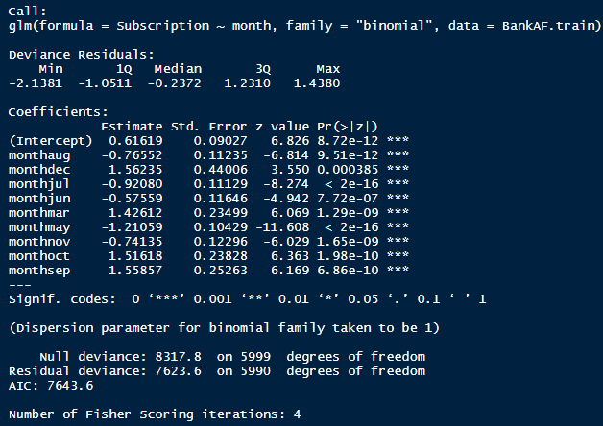
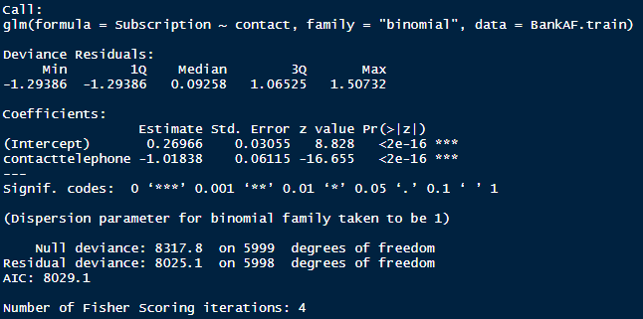
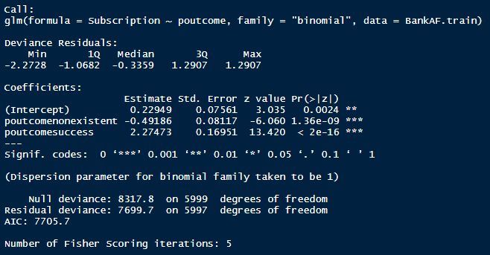
Simple Log categorical trials
Categoricals chosen were month and poutcome I will try to add those to the numeric model

Slide 16
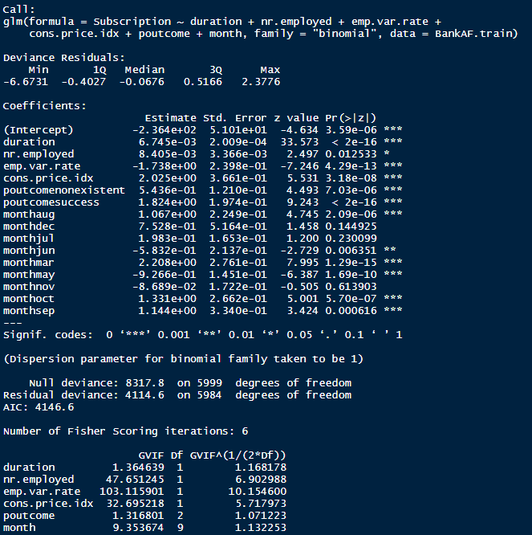
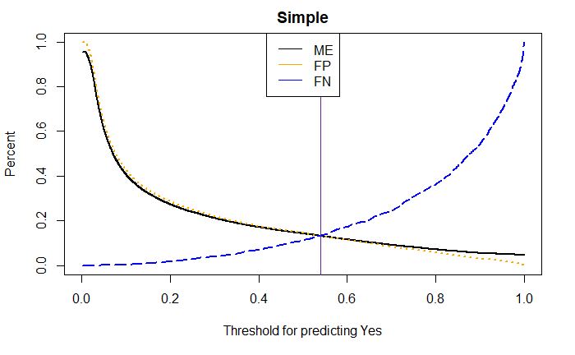
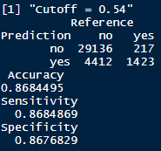
Simple Log Model All Together
Simple Log Model All Together

Slide 17
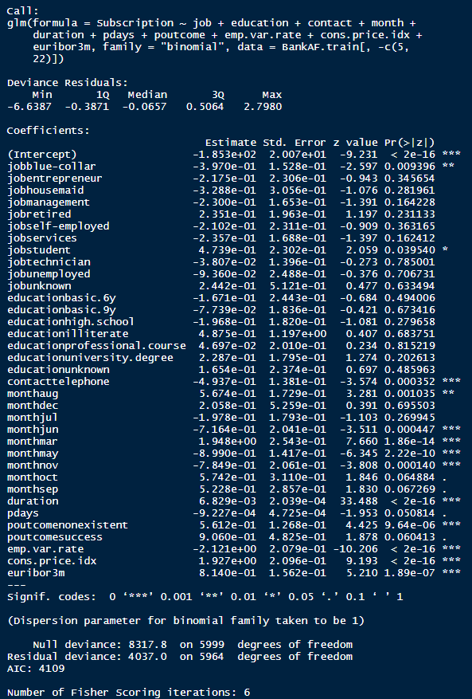
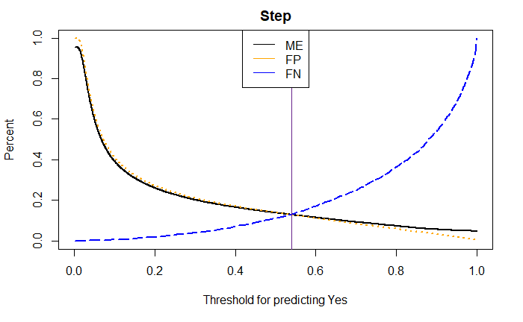
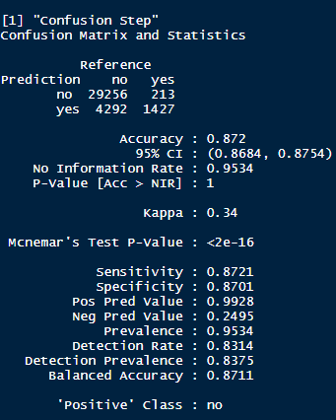
Step Model

Slide 18
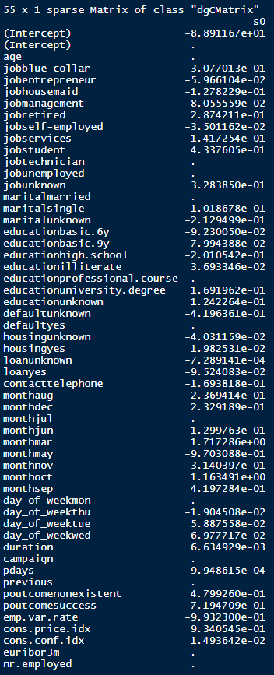
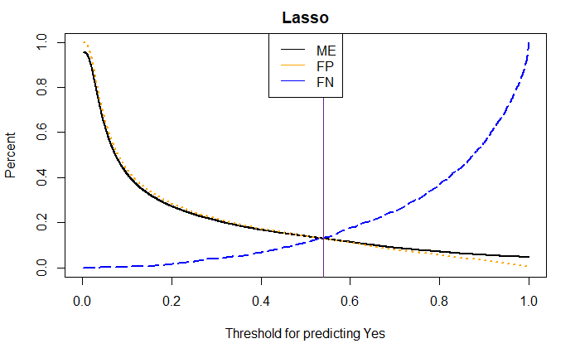

Lasso

Slide 19


Slide 20






Without Duration

Slide 21



Without Duration

Slide 22








Residuals From Logistic Regs – With Duration
Simple – Obs 36,044 massive outlier
Step – same issues with obs 36044

